Slide 1

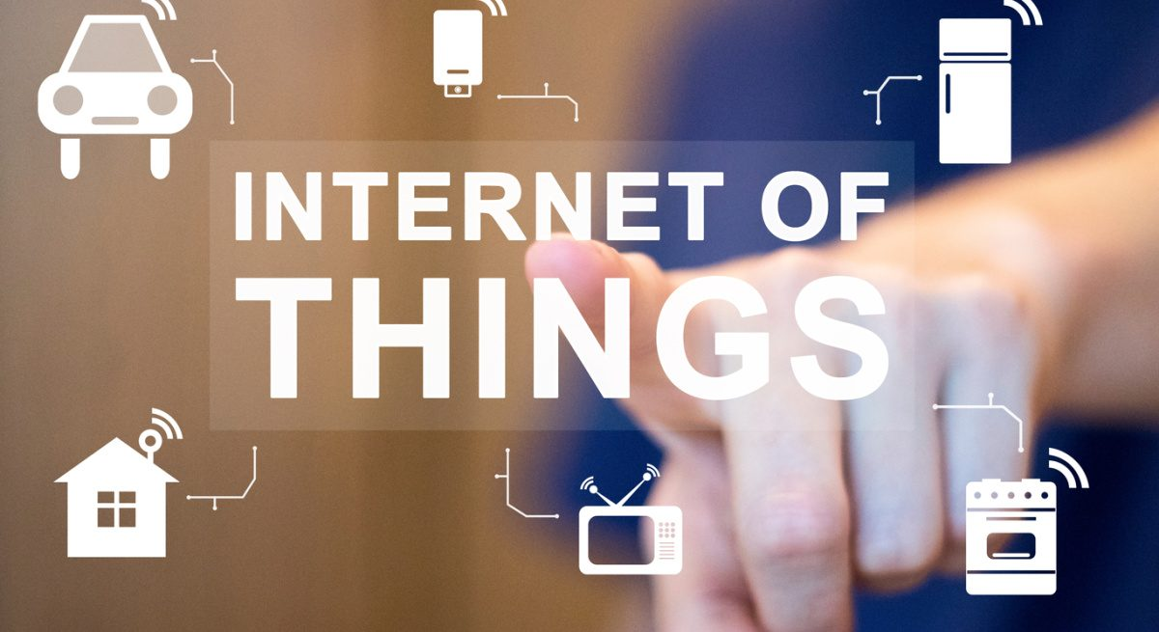
WITH TECH AND AUTOMATION LIFE IS EASY !!!
01

Slide 2

Problem Statement
"In traditional systems, physical devices such as machines, appliances, and infrastructure operate in isolation, making it difficult to monitor their status, collect data in real time, or control them remotely. This leads to inefficiencies, delayed responses, high operational costs, and poor decision-making."
10

Slide 3

Write Your Solution
By connecting devices to the internet, enabling real-time data exchange, remote monitoring, automation, and intelligent decision-making to improve efficiency, reducing costs, and enhancing user experience, IoT is used in general as a solution, with embedded systems performing specific tasks, and automating tasks.
06

Slide 4
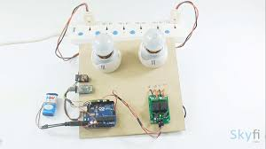
Product
“Embedded systems as my services, are there to automate traditional systems with manual operations. With the use of the micro-controller, embedded systems are capable of solving many problems/challenges faced when using traditional systems.”
04

Slide 5
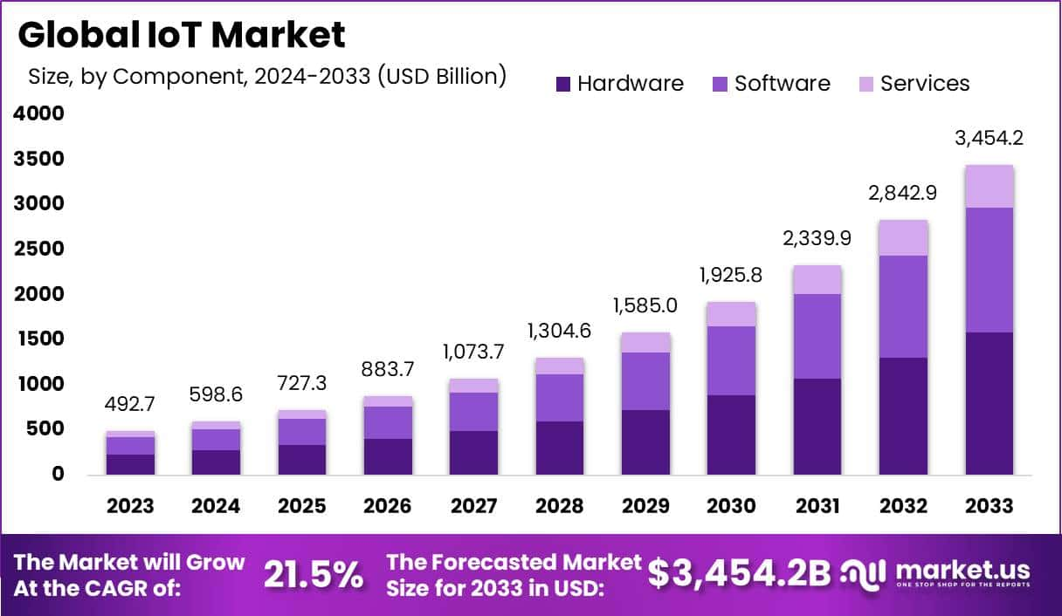
Target Market
.
14

Slide 6
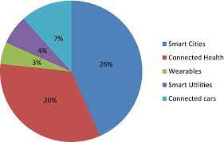
Market Size
The global IoT market is booming—valued at over $500 billion in 2023, it's expected to exceed $3 trillion by 2030, driven by smart homes, smart cities, and industrial automation.

Slide 7

Competitors
Competitors:
PTC(ThingWorx), ARM, Particle
The aim of my project is to focus on local
Problem-Solving, whereby I will be using
IoT and Embedded systems to solve things like load-shedding, Water management, etc
23

Slide 8
Competitive Advantage
I have a broad background in computer systems, which has exposed me to a variety of tech fields such as networking, operating systems, software engineering, digital systems, and electronics. This diverse experience has allowed me to develop a unique skill set, enabling me to approach problems from multiple perspectives.
One of my strengths is my ability to work across different domains. For example, I’m comfortable navigating between hardware and software, which makes me versatile and adaptable in handling complex projects. I’ve developed the ability to understand how different systems interact, whether it’s a digital system's hardware components or the software that makes everything run smoothly.

Slide 9
Project Traction
Tasks
Month 1
Month 2
Month 3
Month 4
Month 5
Problem identification
System Architecture design
Build and test of prototype
Deploying of the prototype and gathering user feedback
Preparation of reports, presentation, and plan for scaling the project
23

Slide 10
Business Model
Hardware Sales – Selling smart devices, sensors, or kits.
Subscription Services – Charging for cloud storage, analytics, or remote access features.
Custom IoT Solutions – Designing and deploying tailored systems for clients (e.g., farms, factories).
Data Monetization – Selling insights or usage data (with user consent).
Maintenance & Support Plans – Charging for system monitoring, updates, and technical support.
23

Slide 11
Go To Market
Partner with local municipalities and utility providers
Attend tech expos, energy summits, and engineering conferences
Launch a website with demos, case studies, and contact forms

Slide 12
Social Impact
SDG 7: Affordable and Clean Energy
SDG 9: Industry, Innovation, and Infrastructure
SDG 11: Sustainable Cities and Communities
SDG 12: Responsible Consumption and Production
SDG 13: Climate Action

Slide 13

Our Ask
I am seeking R300 000 in funding to support the development and deployment of a Smart Energy Management System that will help South African households and businesses mitigate the effects of load-shedding by intelligently switching between grid and solar energy.

Slide 14

Team Members
Sebongile Keswa
Student (Computer systems)
Wamaanda Phaswana
Student (Computer systems)
Elias Metsing
Student (Computer systems)

Slide 15
Thank you!
Contact Number: 063 580 0105
Email address: teboho4000@gmail.com
Linkedin: Teboho Given
17

